Slide 1
BlockChain on Python
스마트금융과

Slide 2
Overview
Characteristics of blockchain
Python
Simple Http Server by Python Make your own code and APIs
Block, Hashing
Transaction Design your transaction model
Making Block
Merge with your BlockChain and Http Server
Propagating Block to other nodes
출처 : http://blockxchain.org/2017/06/04/simple-local-python-blockchain-pt1/

Slide 3
Characteristic of BlockChain
Transactions
Blocks
Snapshot or Chaining between Blocks
Hash for a integrity
Validating of existing Blocks
Interface or Interact with other nodes
etc…

Slide 4
Python development environment
Python
Anaconda
Jupyter
Pycharm
Ftp, Linux Server, REST Test Tool(ARC, Post Man, Fiddler,…)
Git, File Compare Tools …

Slide 5
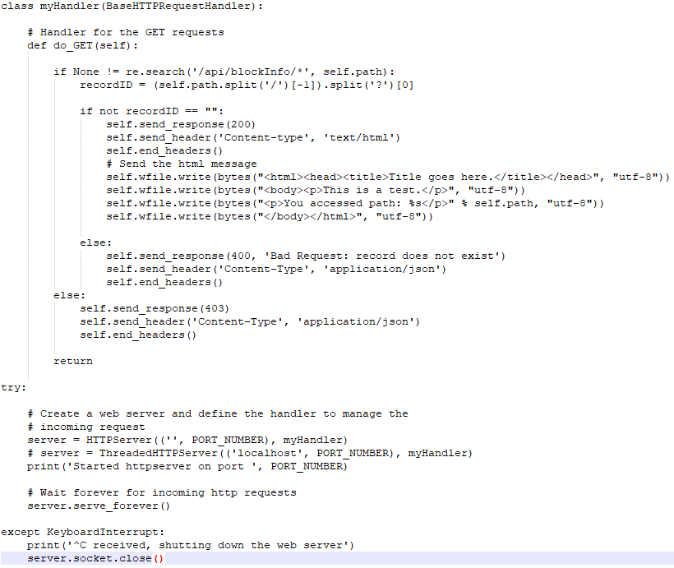
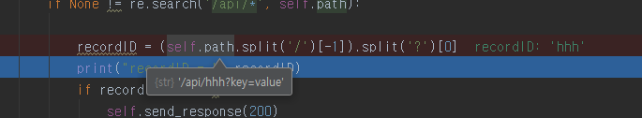
Simple HTTP Server by Python (GET)
참조 : https://docs.python.org/3/library/http.server.html?highlight=basehttprequesthandler#http.server.BaseHTTPRequestHandler
참조 : https://mafayyaz.wordpress.com/2013/02/08/writing-simple-http-server-in-python-with-rest-and-json/
Notes:
http://localhost:8090/api/1?key=value
http://www.nextree.co.kr/p4327/

Slide 6
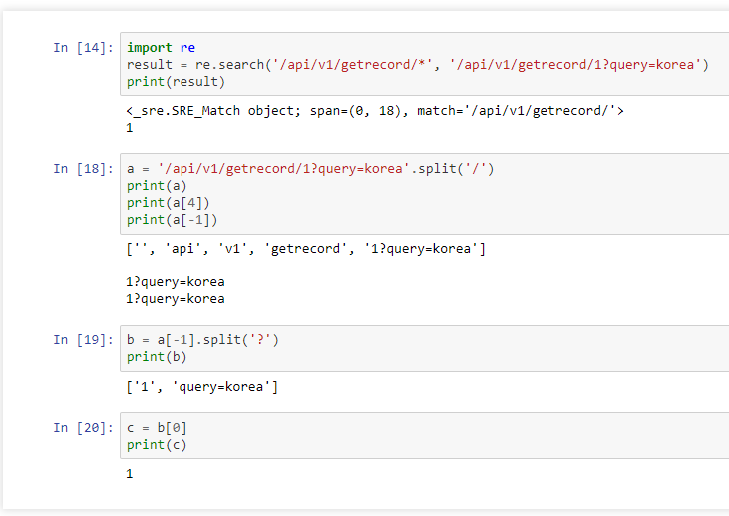
Simple HTTP Server by Python (GET) – Review
python 문자열 다루기 : split
Notes:
python -m http.server 8080
http://192.168.110.116:8080/split_ex.html

Slide 7
Practice #1
Make your own APIs on Development Server
포트 번호 : 80 + 학번 끝 두자리로 설정
API Spec 작성 및 테스트 결과를 Development Server에 업로드 - 업로드 위치 : /home/smrt00xx/… - 실행 : python server.py - 테스트 : http://192.168.110.116:80xx/api/v1/getrecord - API Spec. : API기본정보(요청URL, 포맷, 방식), 요청변수, 출력결과, 에러코드

Slide 8
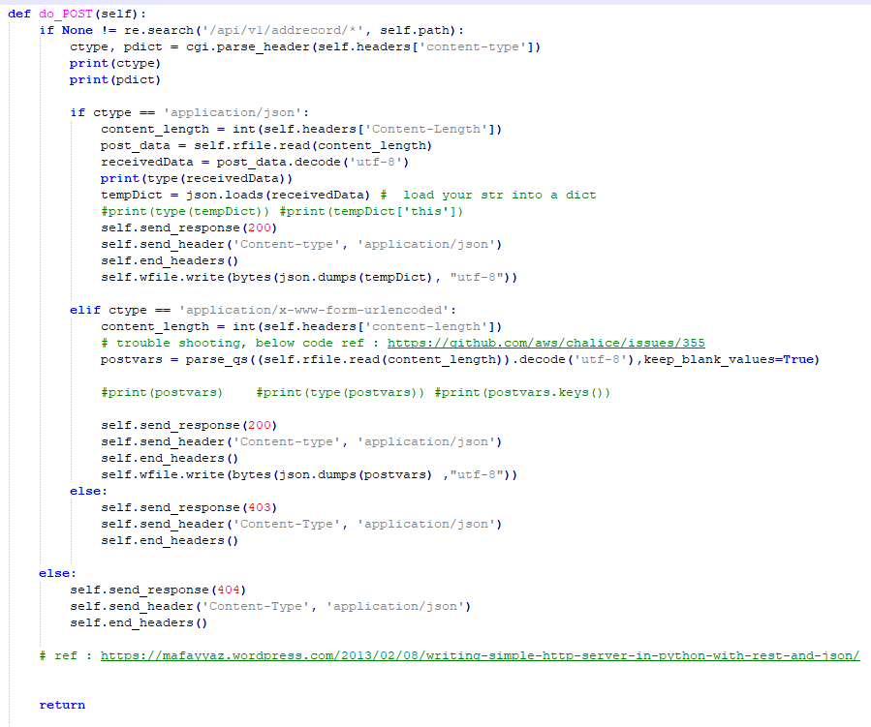
Simple HTTP Server by Python (POST)

Slide 9
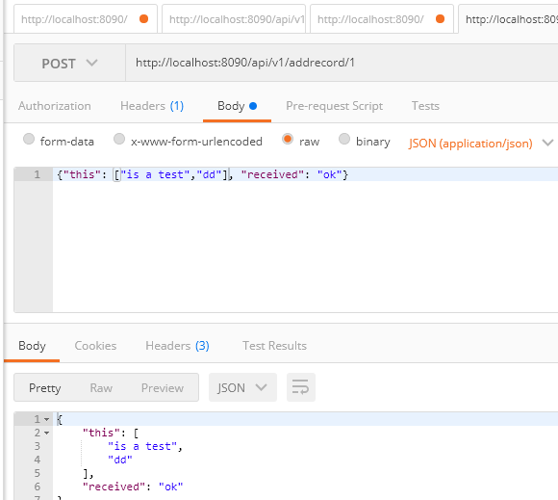

Simple HTTP Server by Python (POST)

Slide 10
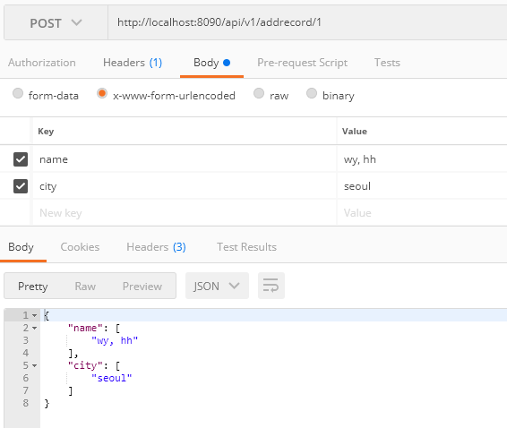
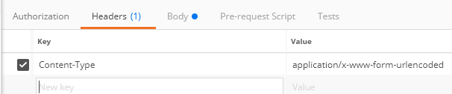
Simple HTTP Server by Python (POST)

Slide 11
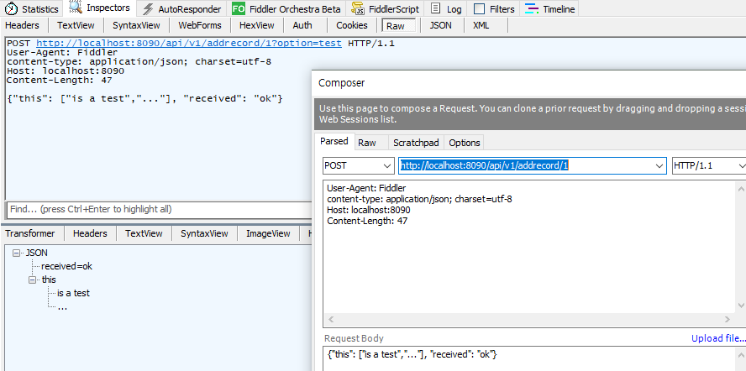
Simple HTTP Server by Python (POST)

Slide 12
Practice #2
Make your own APIs on Development Server
포트 번호 : 80 + 학번 끝 두자리로 설정
API Spec 작성 및 테스트 결과를 Development Server에 업로드 - 업로드 위치 : /home/smrt00xx/… - 실행 : python server.py - 테스트 : http://192.168.110.116:80xx/api/v1/getrecord - API Spec. : API기본정보(요청URL, 포맷, 방식), 요청변수, 출력결과, 에러코드

Slide 13
Genesis Block
5 Attributes
Index – it’s position in the blockchain
Previous Hash – the hash of the block that came before the current block
Timestamp – the time the block was created
Data – the information (e.g. transactions) that the block carries
Hash – the hash of the block itself.
출처 : http://blockxchain.org/2017/06/04/simple-local-python-blockchain-pt1/

Slide 14
Genesis Block
class Block:
#A basic block contains, index (blockheight), the previous hash, a timestamp, tx information, a nonce, and the current hash
def __init__(self, index, previousHash, timestamp, data, proof, currentHash):
self.index = index
self.previousHash = previousHash
self.timestamp = timestamp
self.data = data
self.currentHash = currentHash
self.proof = proof
출처 : http://blockxchain.org/2017/06/04/simple-local-python-blockchain-pt1/

Slide 15
Genesis Block
Now we can create genesis block.
def getGenesisBlock():
timestamp = time.time()
print("# timestamp를 찍어본다.")
print("time.time() => %f \n" % timestamp)
tempHash = calculateHash(0,'0',timestamp,"My very first block :)",0)
print(tempHash)
return Block(0, '0', timestamp, "My very first block :)", 0, tempHash)
blockchain = [getGenesisBlock()]
출처 : http://blockxchain.org/2017/06/04/simple-local-python-blockchain-pt1/

Slide 16
Hashing Blocks
Hash 대상 : 현재 블록의 인덱스 + 이전 블록의 Hash + 현 블록의 TimeStamp + 현 블록의 거래데이터 + PoW(#)
def calculateHash(index, previousHash, timestamp, data, proof):
value = str(index) + str(previousHash) + str(timestamp) + str(data) + str(proof)
sha = hashlib.sha256(value.encode('utf-8'))
return str(sha.hexdigest())
출처 : http://blockxchain.org/2017/06/04/simple-local-python-blockchain-pt1/

Slide 17
Creating New Blocks
def getLatestBlock(blockchain):
return blockchain[len(blockchain)-1]
def generateNextBlock(blockchain, blockData, timestamp, proof):
previousBlock = getLatestBlock(blockchain)
nextIndex = int(previousBlock.index) + 1
nextTimestamp = timestamp
nextHash = calculateHash(nextIndex, previousBlock.currentHash, nextTimestamp, proof, blockData)
return Block(nextIndex, previousBlock.currentHash, nextTimestamp, blockData, proof, nextHash)
배열
출처 : http://blockxchain.org/2017/06/04/simple-local-python-blockchain-pt1/

Slide 18
So far we can
Create a genesis block
Hash blocks
Create additional blocks
출처 : http://blockxchain.org/2017/06/04/simple-local-python-blockchain-pt1/

Slide 19
Validation Blocks
def isSameBlock(block1, block2):
if block1.index != block2.index:
return False
elif block1.previousHash != block2.previousHash:
return False
elif block1.timestamp != block2.timestamp:
return False
elif block1.data != block2.data:
return False
elif block1.currentHash != block2.currentHash:
return False
return True
출처 : http://blockxchain.org/2017/06/04/simple-local-python-blockchain-pt1/

Slide 20
Validation Blocks
def isValidChain(bcToValidate):
if not isSameBlock(bcToValidate[0], getGenesisBlock()):
print('Genesis Block Incorrect')
return False
tempBlocks = [bcToValidate[0]]
for i in range(1, len(bcToValidate)):
if isValidNewBlock(bcToValidate[i], tempBlocks[i-1]):
tempBlocks.append(bcToValidate[i])
else:
return False
return True
출처 : http://blockxchain.org/2017/06/04/simple-local-python-blockchain-pt1/

Slide 21
Validation Blocks
def isValidNewBlock(newBlock, previousBlock):
if previousBlock.index + 1 != newBlock.index:
print('Indices Do Not Match Up')
return False
elif previousBlock.currentHash != newBlock.previousHash:
print("Previous hash does not match")
return False
elif calculateHashForBlock(newBlock) != newBlock.hash:
print("Hash is invalid")
return False
return True
출처 : http://blockxchain.org/2017/06/04/simple-local-python-blockchain-pt1/

Slide 22
Making TxData
“User <random number> sent <random number> tokens to user <random number>.”
def getTxData():
txData = ''
for _ in range(5):
txTo, txFrom, amount = random.randrange(0, 1000), random.randrange(0, 1000), random.randrange(0, 100)
transaction = 'User ' + str(txFrom) + " sent " + str(amount) + ' tokens to user ' + str(txTo) + ". "
txData += transaction
return txData
> TxData looks like …
출처 : http://blockxchain.org/2017/06/04/simple-local-python-blockchain-pt1/

Slide 23
Mine New Block
def mineNewBlock(difficulty = 5, blockchainPath = 'blockchain.csv'):
blockchain = readBlockchain(blockchainPath)
txData = getTxData()
timestamp = time.time()
proof = 0
newBlockFound = False
print('Mining a block...')
while not newBlockFound:
#print("Trying new block proof...")
newBlockAttempt = generateNextBlock(blockchain, txData, timestamp, proof)
if newBlockAttempt.currentHash[0:difficulty] == '0'*difficulty:
stopTime = time.time()
timer = stopTime - timestamp
print('New block found with proof', proof, 'in', round(timer, 2), 'seconds.')
newBlockFound = True
else:
proof += 1
blockchain.append(newBlockAttempt)
writeBlockchain(blockchain)
def mine(blocksToMine = 5):
for _ in range(blocksToMine):
mineNewBlock()
출처 : http://blockxchain.org/2017/06/04/simple-local-python-blockchain-pt1/

